Slide 1




Churn Prediction Project
By: G-1 Team

Slide 2
G-1 Team Members
Ammar Alhawashem
Maram Alzahrani
Noof Alsafi
Taif Alzahr
Sara
Noura Alajmi
Hibah Sindi
Shahad Ali
Reema Almeshal
Raya

Slide 3
Outlines:
Project Overview
Data Analysis and Visualization
Clustering
Predictive Model
SVM model
RF model
XG Boost model
Multi Layer perceptrons
Model Deployment
Conclusion

Slide 4
Project Overview

Slide 5
Problem Statement
The project involves predicting employee churn using HR data, conducting exploratory data analysis, preprocessing, clustering analysis and employing classification algorithms, and deploying the best model via Streamlit

Slide 6
Goal
Develop a robust predictive model leveraging HR data to accurately forecast employee churn, enabling companies to proactively address retention strategies and reduce attrition rates

Slide 7
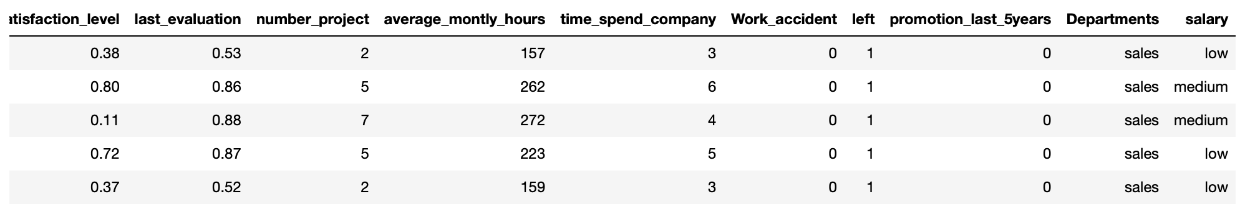
Dataset
The dataset comprises various HR-related attributes for company employees, including satisfaction levels, performance evaluations, project assignments, monthly working hours, and tenure

Slide 8
Data Analysis and Visualization
2
Notes:
where it can classify new images based on their textual descriptions without the need for explicit training on specific image classes.

Slide 9
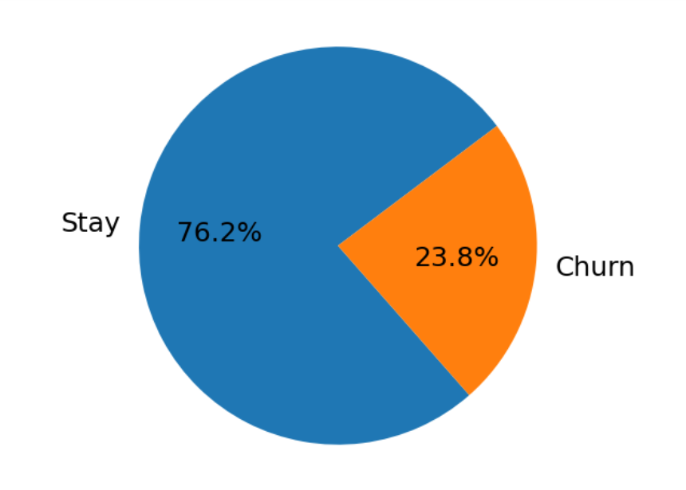
Employees churn distribution
2
Notes:
where it can classify new images based on their textual descriptions without the need for explicit training on specific image classes.

Slide 10
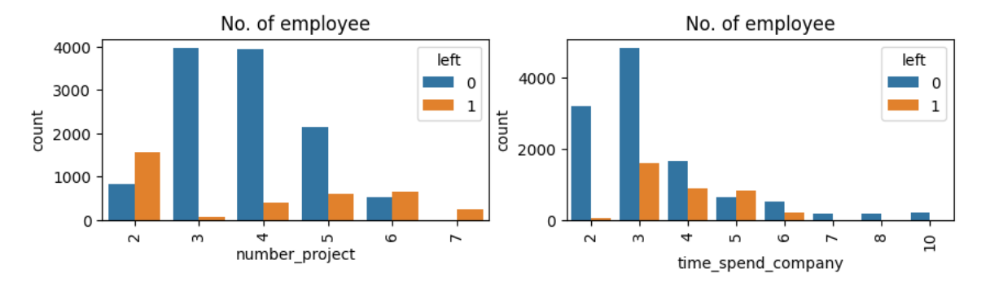
Employee Departure Analysis Across Factors
2
Notes:
where it can classify new images based on their textual descriptions without the need for explicit training on specific image classes.

Slide 11
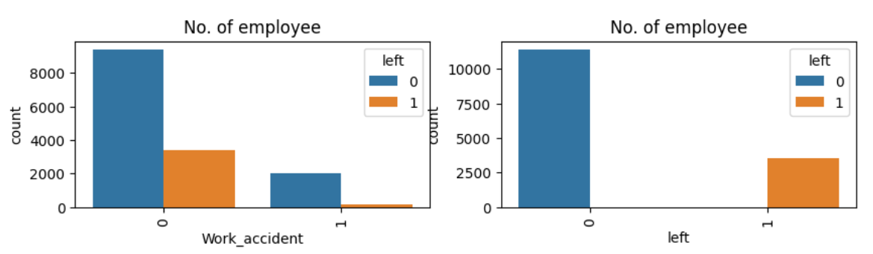
Employee Departure Analysis Across Factors
2
Notes:
where it can classify new images based on their textual descriptions without the need for explicit training on specific image classes.

Slide 12
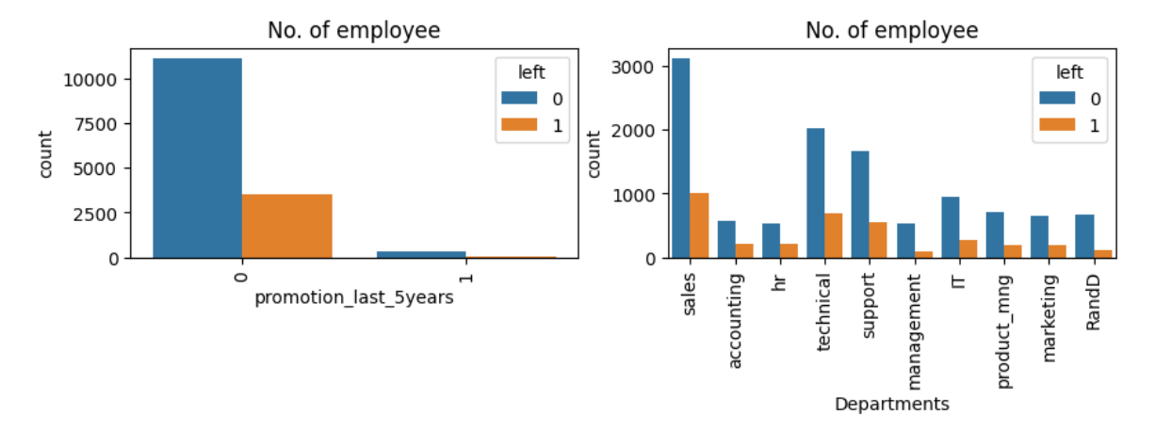
Employee Departure Analysis Across Factors
2
Notes:
where it can classify new images based on their textual descriptions without the need for explicit training on specific image classes.

Slide 13
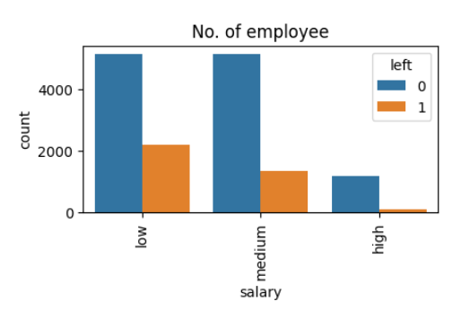
Employee Departure Analysis Across Factors
2
Notes:
where it can classify new images based on their textual descriptions without the need for explicit training on specific image classes.

Slide 14
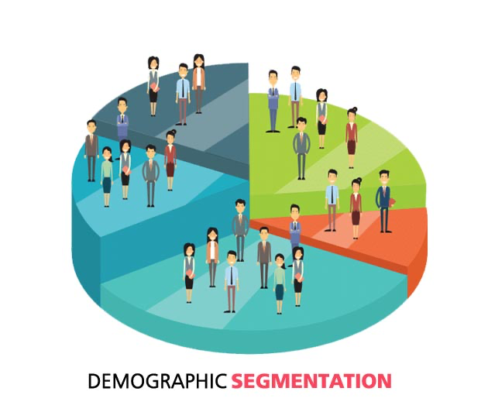
Clustering

Slide 15
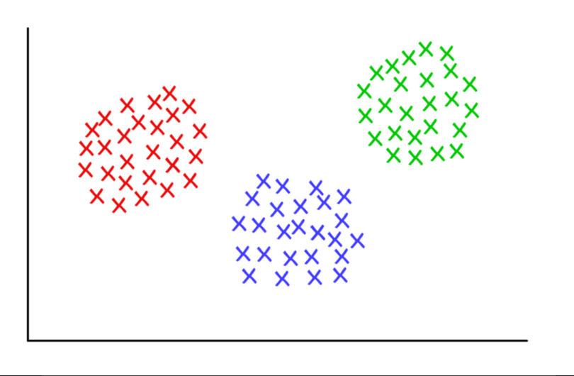
What is clustering?
Grouping similar data points together based on their inherent characteristics or patterns.

Slide 16
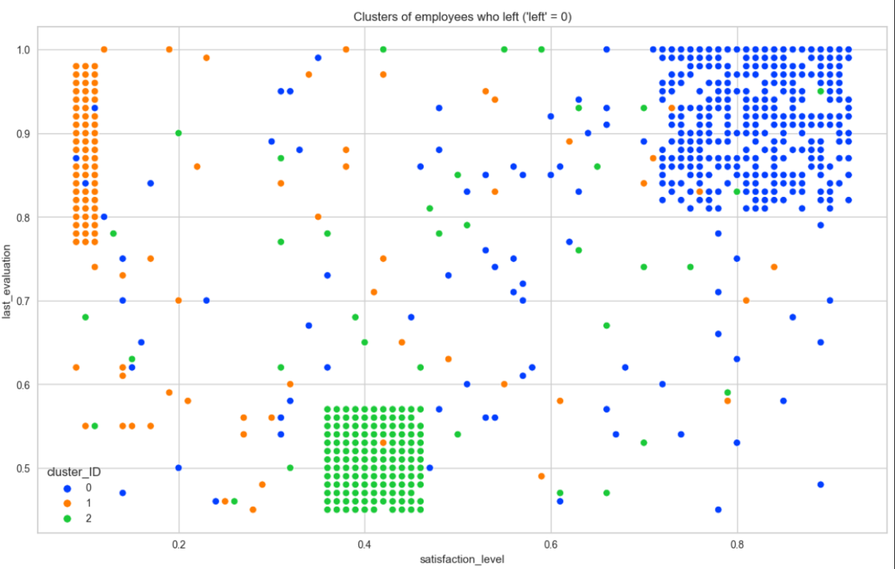
clustering results

Slide 17
Predictive Model
Notes:
In Linear Algebra, one common way to measure if two vectors are of similar characteristics (they are like each other) is to calculate their dot product (multiplying the matching entries and take the sum of them); if the final number is big, they are alike and if it is small they are not (relatively speaking)!

Slide 18
Predictive Model Building
Classification algorithms we applied:
Support Vector Machine (SVM)
Random Forest (Bagging)
XGBoost (Boosting)
Multi Layer perceptrons (MLP)
Notes:
In Linear Algebra, one common way to measure if two vectors are of similar characteristics (they are like each other) is to calculate their dot product (multiplying the matching entries and take the sum of them); if the final number is big, they are alike and if it is small they are not (relatively speaking)!

Slide 19
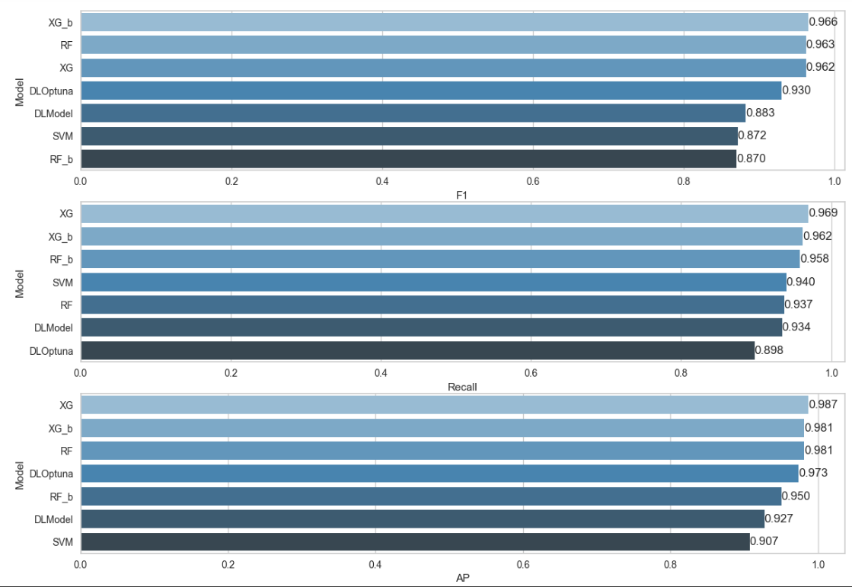
Predictive Models Results Comparison
Notes:
In Linear Algebra, one common way to measure if two vectors are of similar characteristics (they are like each other) is to calculate their dot product (multiplying the matching entries and take the sum of them); if the final number is big, they are alike and if it is small they are not (relatively speaking)!

Slide 20
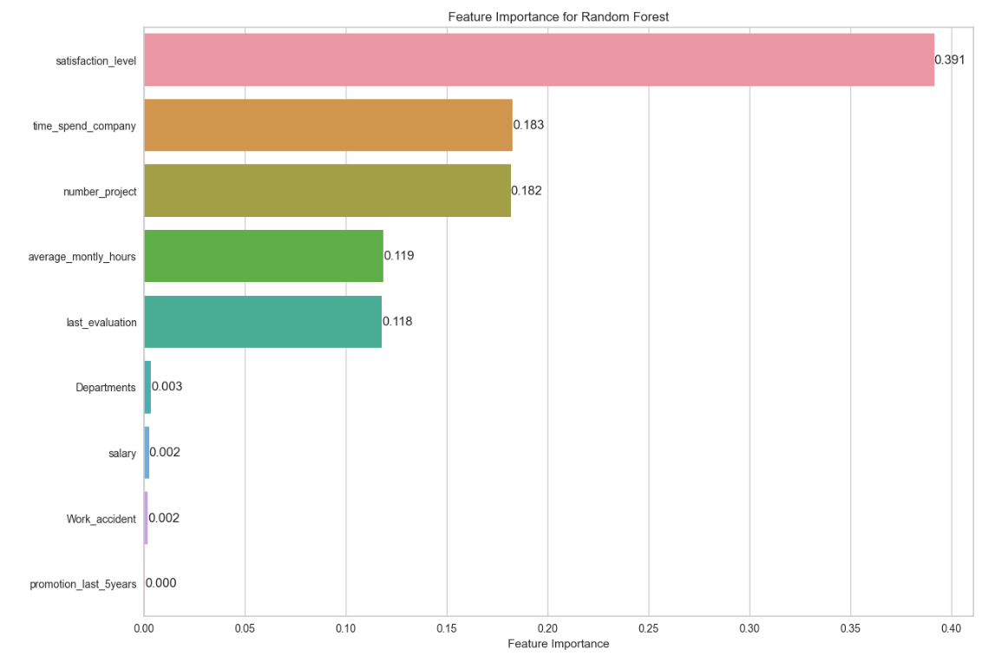
Features Importance for the Best Model
Notes:
In Linear Algebra, one common way to measure if two vectors are of similar characteristics (they are like each other) is to calculate their dot product (multiplying the matching entries and take the sum of them); if the final number is big, they are alike and if it is small they are not (relatively speaking)!

Slide 21
Model Deployment
Notes:
In Linear Algebra, one common way to measure if two vectors are of similar characteristics (they are like each other) is to calculate their dot product (multiplying the matching entries and take the sum of them); if the final number is big, they are alike and if it is small they are not (relatively speaking)!

Slide 22
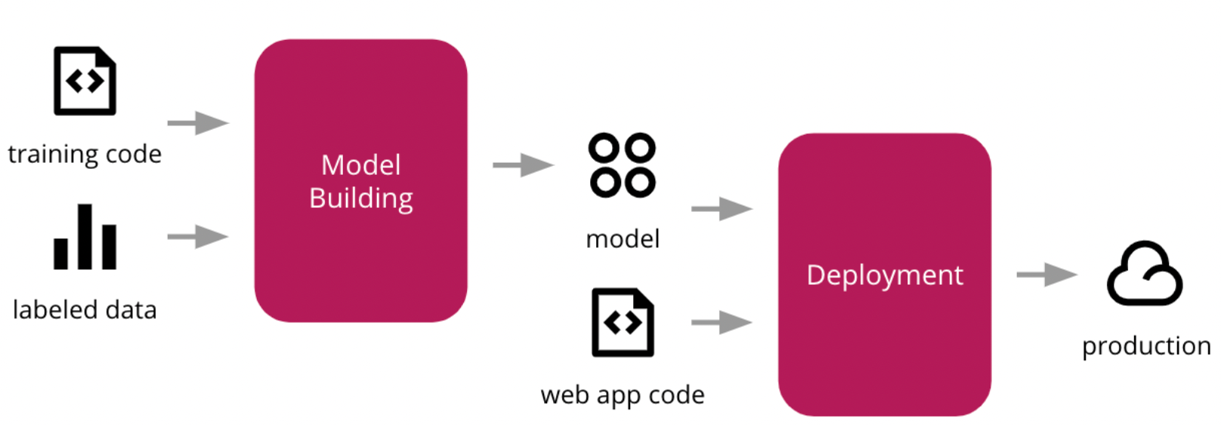
What is Model Deployment?
Deployment means putting a machine learning model into action in a real business setting to make decisions based on data. It's one of the last steps in the machine learning process.
In this project we deployed our ML model with Streamlit on AWS.

Slide 23

Employee Churn Prediction App
Page 1

Slide 24
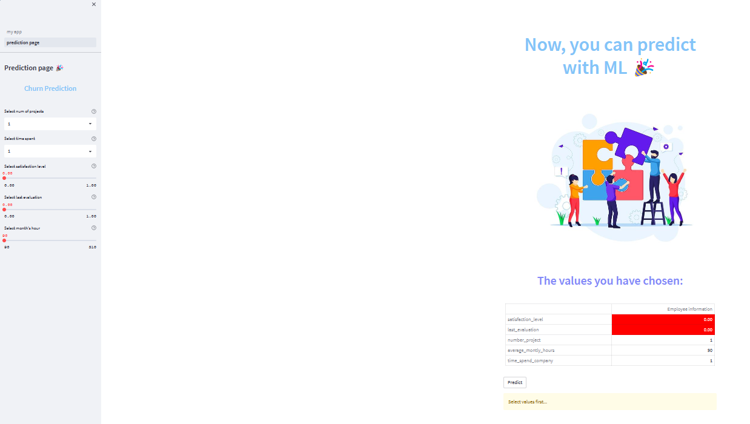
Employee Churn Prediction App
Page 2

Slide 25

Visit Our App
Demo
URL

Slide 26
Conclusion
Notes:
In Linear Algebra, one common way to measure if two vectors are of similar characteristics (they are like each other) is to calculate their dot product (multiplying the matching entries and take the sum of them); if the final number is big, they are alike and if it is small they are not (relatively speaking)!

Slide 27
In this project we deploy a Streamlit app that predicts employees churn based on user inputs. The app loads a trained Random Forest classifier model and applies it to the user input data to predict whether or not the employee is likely to churn.
Notes:
In Linear Algebra, one common way to measure if two vectors are of similar characteristics (they are like each other) is to calculate their dot product (multiplying the matching entries and take the sum of them); if the final number is big, they are alike and if it is small they are not (relatively speaking)!

Slide 28
Thanks for Listening

